Slide 1

ELECTION MANAGEMENT SYSTEM
Submitted to:-
Department: Training and Placement
Faculty: Praveen Sharma
Submitted by:-
Student Name: Shubham Pandey
Enrollment No: 0176EC181022
Branch: EC (LNCT&E)
Semester: 6TH

Slide 2
DECLARATION
I hereby declare that this project of “Election Management System” has not been copied from anywhere but designed & developed by me with the help of my college faculties ,friends for which I am very thankful to them.
Student Name: Shubham Pandey
Enrollment No: 0176EC181022

Slide 3
INDEX
Introduction
Project Overview
Output Screen
Data Flow Diagram
Project Flow
Requirements
System Design
Future Enhancement
Conclusion

Slide 4
INTRODUCTION
“ONLINE VOTING SYSTEM” is an online voting technique. In this system people who are citizens and whose age is above 18 years of age and any sex can give his her vote online without going to any physical polling station.
In “ONLINE VOTING SYSTEM” a voter can use his her voting right online without any difficulty. He She has to be registered first for him/her to vote manually. Registration is mainly done by the system administrator for security reasons. After registration, the voter is assigned a secret Login ID and password with which he/she can use to log into the system and enjoy services provided by the system such as voting. If invalid/wrong details are submitted, then the citizen is not registered to vote.

Slide 5
Project Overview
Login:-
For Admin Admin Username& Password Status Login Create Voter Create Candidate Voter’s entry Candidate’s entry Voter Candidate Voter’s Details Stored Candidate’s Details Stored.
For Voter Login Voting Result Voter Voter Candidate Vote_update Username& Password Status Voter’s Info Authentication Candidate’s Info Accumulated Votes Counted Votes Result to Voter

Slide 6
1)Registration of the voter is done by ELECTION AUTHORITY. 2) ELECTION AUTHORITY can change the information any time if required. 3) Registration of the Voter depends upon the information filled by the user manually to the ELECTION AUTHORITY. 4) Voter is given a unique Login ID and PASSWORD. 5) In the DATABASE information of every voter is stored. 6) Database shows the information of every user.
Requirements

Slide 7
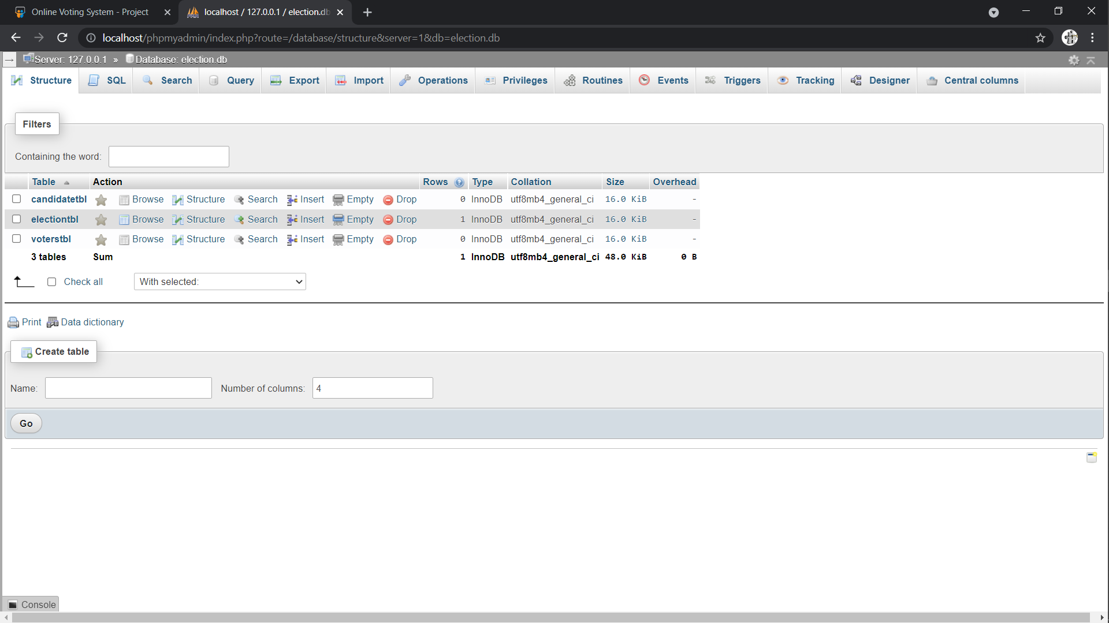
Database Screenshot

Slide 8
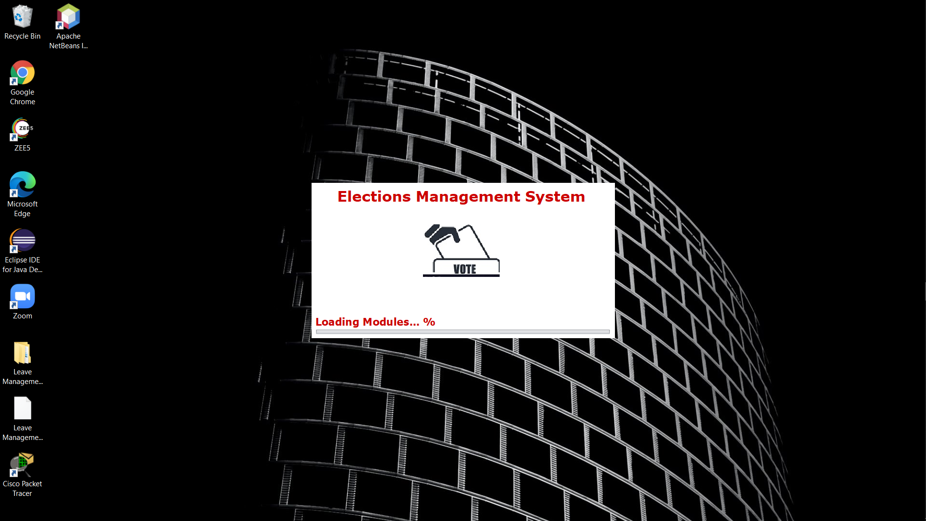
Output Screen

Slide 9
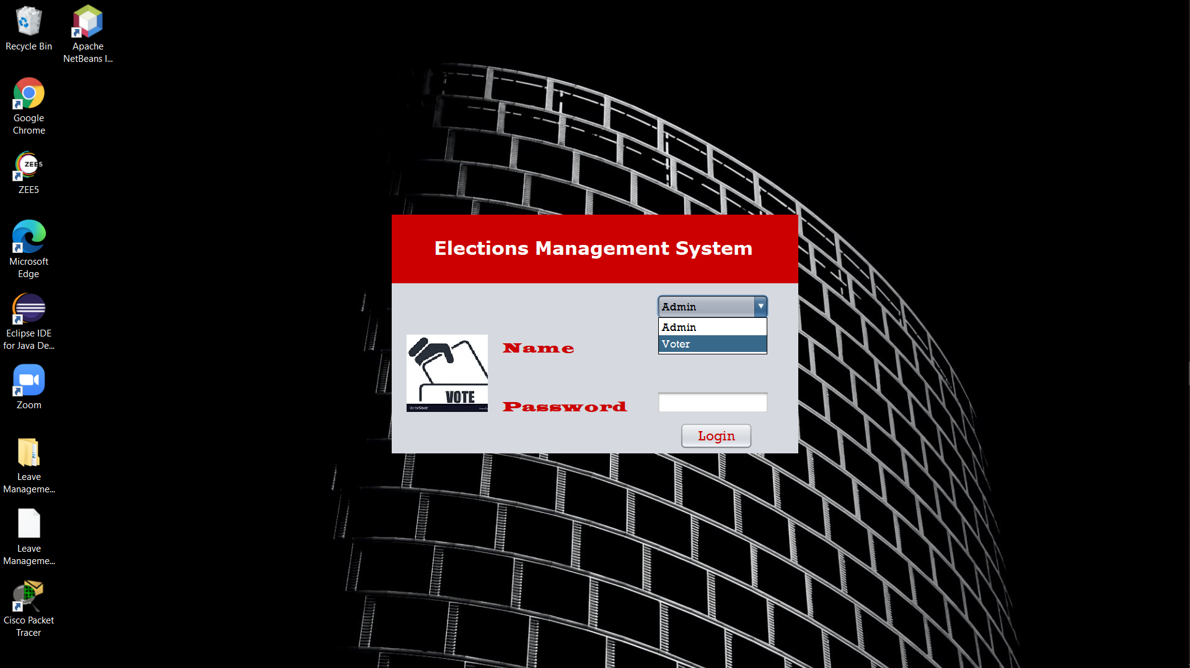
Output Screen

Slide 10
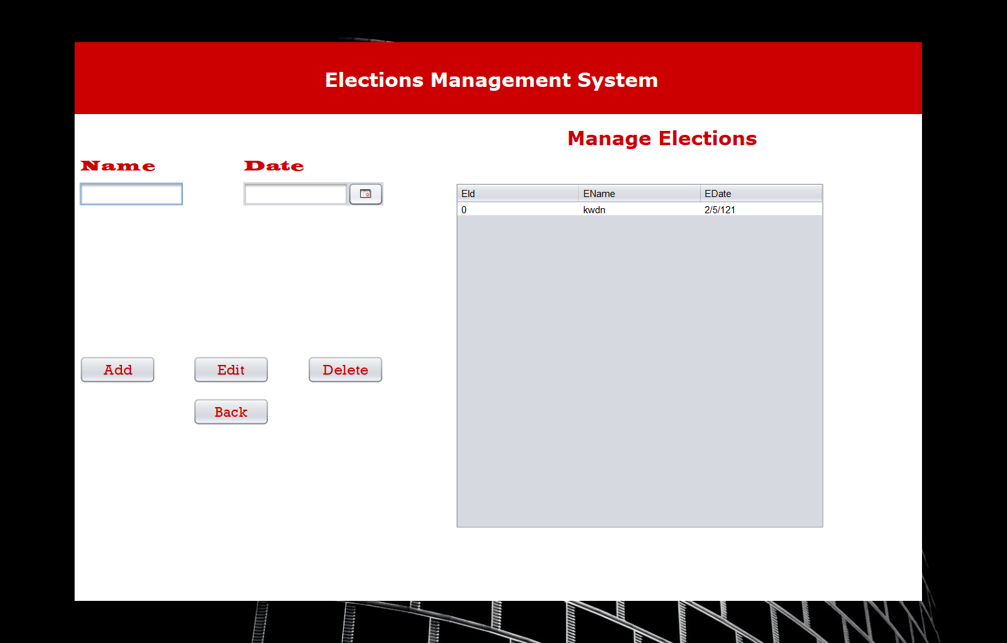
Output Screen

Slide 11
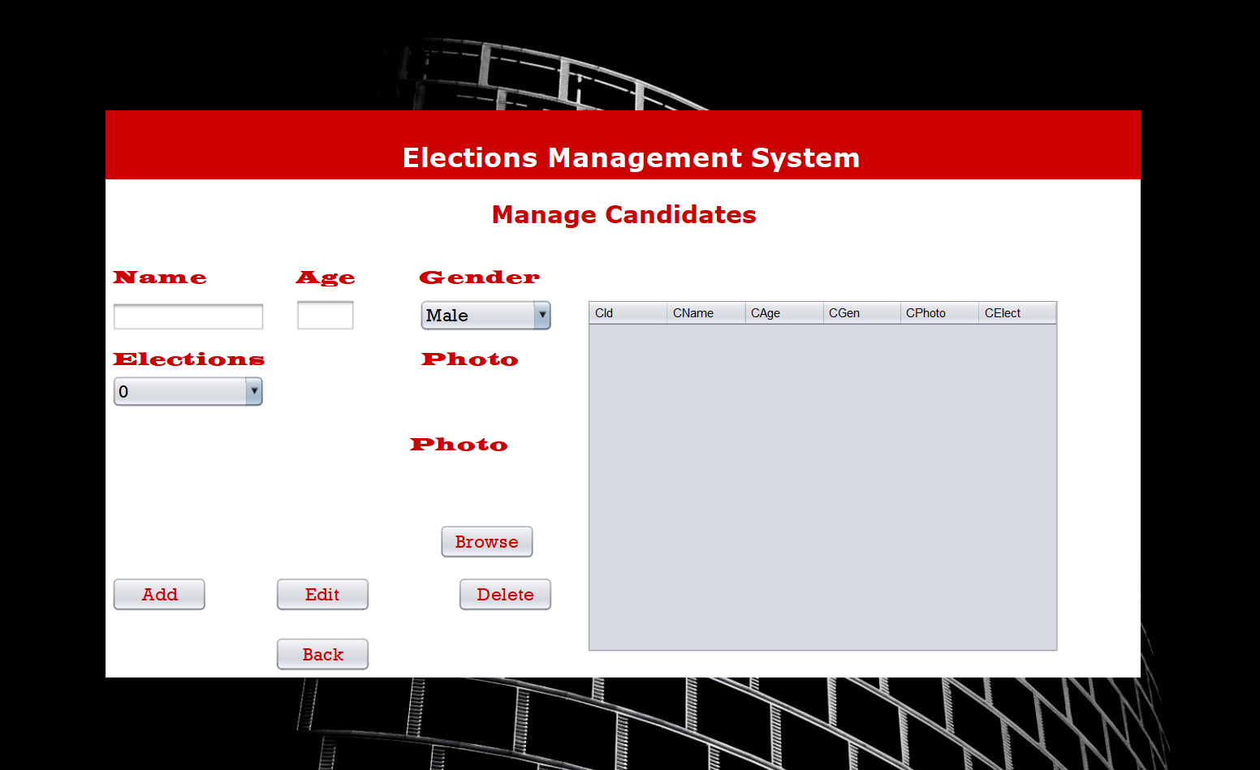
Output Screen

Slide 12
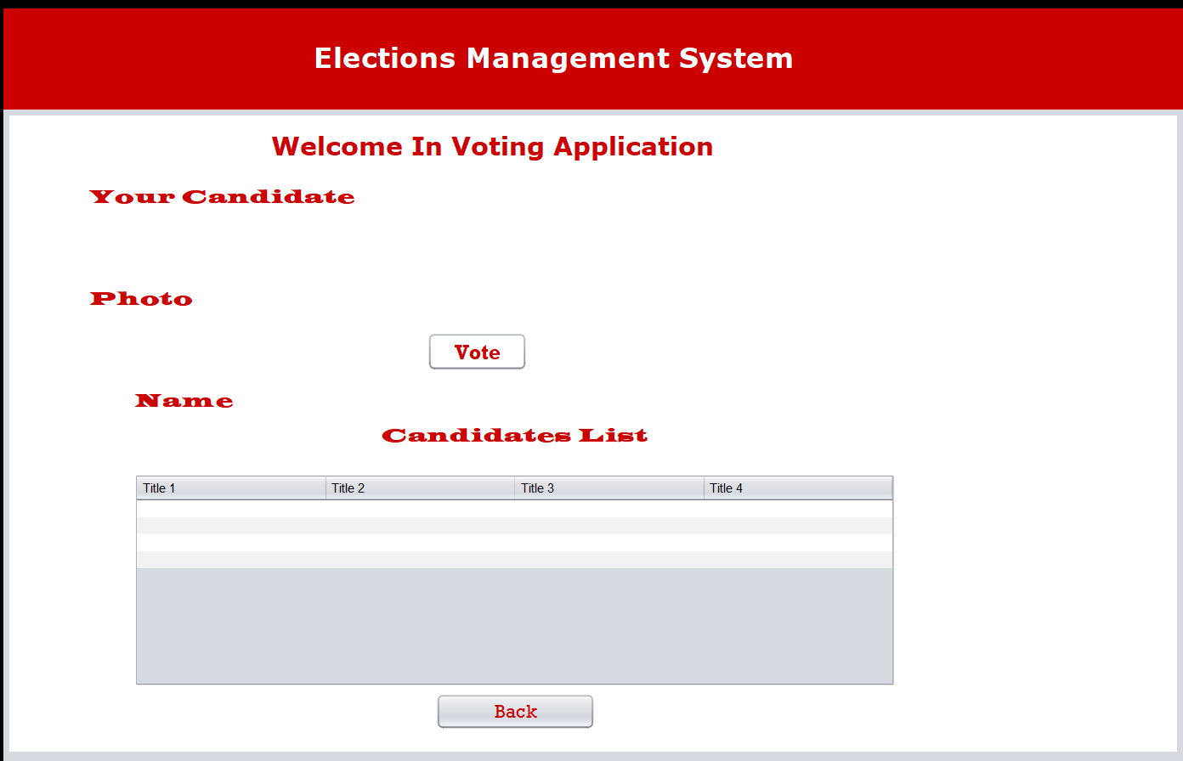
Output Screen

Slide 13
Data Flow Diagram
Data flow diagram is used to define the flow of the system and its resources such as information. Data flow diagrams are a way of expressing project requirements in a graphical manner. Data flow diagram represents one of the most ingenious tools used for structured analysis. A Data Flow Diagram or DFD, as it shortly called is known as bubble chart. It has the purpose of clarifying system requirements and identifying major transformations that will become programs in the system design. It is the major starting point in the design phase thatfunctionally decomposes the requirements specifications down to the lowest level of detail.

Slide 14
PROJECT FLOW
Context Diagram
VOTER
ADMIN
+
LOGIN
LOGINFAILED

Slide 15
Requirements
SOFTWARE REQUIREMENTS SPECIFICATION
Operating System : Windows 7
Programming Language : JAVA
User Interface : CONSOLE APPLICATION
HARDWARE REQUIREMENTS SPECIFICATION
Processor : Intel core i3 or higher
RAM : Minimum of 2GB RAM
Memory :1 GB or higher

Slide 16
System Design
Introduction
System design is the creation of road map that shows system developers how to convert system requirements into a workable and operational system by exploring system and identifying the best design for the project.
Logical design
Logical design identifies the record and relationship to be handled by the system. It focuses on the logic, or the reasoning, behind the system by breaking down the system into sub system until the process cannot be repeated any further.

Slide 17
Future Enhancement
❖ Reviewing the existing/current voting process;  Coming up with an automated voting system;  Implementing a an automated/online voting system
❖ Validating the system to ensure that only legible voters are allowed to vote.

Slide 18
Conclusion
The ONLINE VOTING SYSTEM-INDIA shall reduce the time spend making long queues at the polling stations during voting. It shall also enable the voters to vote from any part of the globe as explained since this is an online application available on the internet. Cases of vote miscounts shall also be solved since at the backend of this system resides a well-developed database using SQL Server that can provide the correct data once it’s correctly queried. Since the voting process shall be open as early as possible, the voters shall have ample time to decide when and whom to vote for. SCOPE OF STUDYIt is focused on studying the existing system of voting and to make sure that the peoples vote is counts, for fairness in the elective positions. This is also will produce: • Less effort and less labor intensive, as the primary cost and focus primary on creating, managing, and running a secure web voting portal. • Increasing number of voters as individuals will find it easier and more convenient to vote, especially those abroad.

Slide 19
THANK
YOU

